Slide 1
GPU-to-GPU and Host-to-Host
Multipattern String Matching on a GPU
Author: Xinyan Zha and Sartaj Sahni
Publisher: IEEE TRANSACTIONS ON COMPUTERS
Presenter: Yu Hao, Tseng
Date: 2013/09/04

Slide 2
Outline
Introduction
GPU-TO-GPU
HOST-TO-HOST
Experimental Results

Slide 3
Introduction
Several researchers have attempted to improve the performance of multistring matching applications through the use of parallelism.
Our focus in this paper is accelerating the AC and Boyer-Moore multipattern string matching algorithms through the use of a GPU.

Slide 4

GPU-TO-GPU
Strategy
  To compute the ith output block, it is sufficient for us to use AC on $input[b∗S_{block}−maxL+1:\left(b+1\right)∗S_{block}−1]$
maxL－ 1
Input
…
block
block
block
…
block

Slide 5

GPU-TO-GPU (Cont.)
Strategy
  To compute the ith output block, it is sufficient for us to use mBM on $input[b∗S_{block}:\left(b+1\right)∗S_{block}+maxL−2]$
maxL－ 1
Input
…
block
block
block
…
block

Slide 6
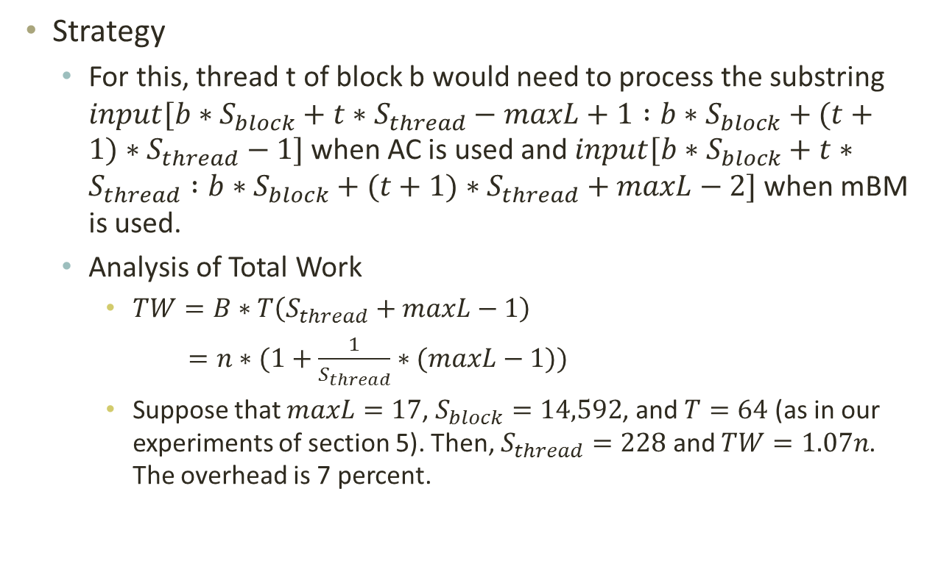
GPU-TO-GPU (Cont.)
Strategy
  For this, thread t of block b would need to process the substring $input[b∗S_{block}+t∗S_{thread}−maxL+1 :b∗S_{block}+(t+1)∗S_{thread}−1]$ when AC is used and $input[b∗S_{block}+t∗S_{thread} :b∗S_{block}+(t+1)∗S_{thread}+maxL−2]$ when mBM is used.
  Analysis of Total Work
    $TW=B∗T\left(S_{thread}+maxL−1\right)$
    $=n∗(1+\frac{1}{S_{thread}}∗(maxL−1))$
    Suppose that $maxL=17$, $S_{block}=14,592$, and $T=64$ (as in our experiments of section 5). Then, $S_{thread}=228$ and $TW=1.07n$. The overhead is 7 percent.

Slide 7
GPU-TO-GPU (Cont.)
Addressing the Deficiencies
  Deficiency D1-Reading from Device Memory
  Deficiency D2-Writing to Device Memory

Slide 8
HOST-TO-HOST
Strategies
  Strategy A
  Strategy B
Write
process
read
Write
process
read

Slide 9
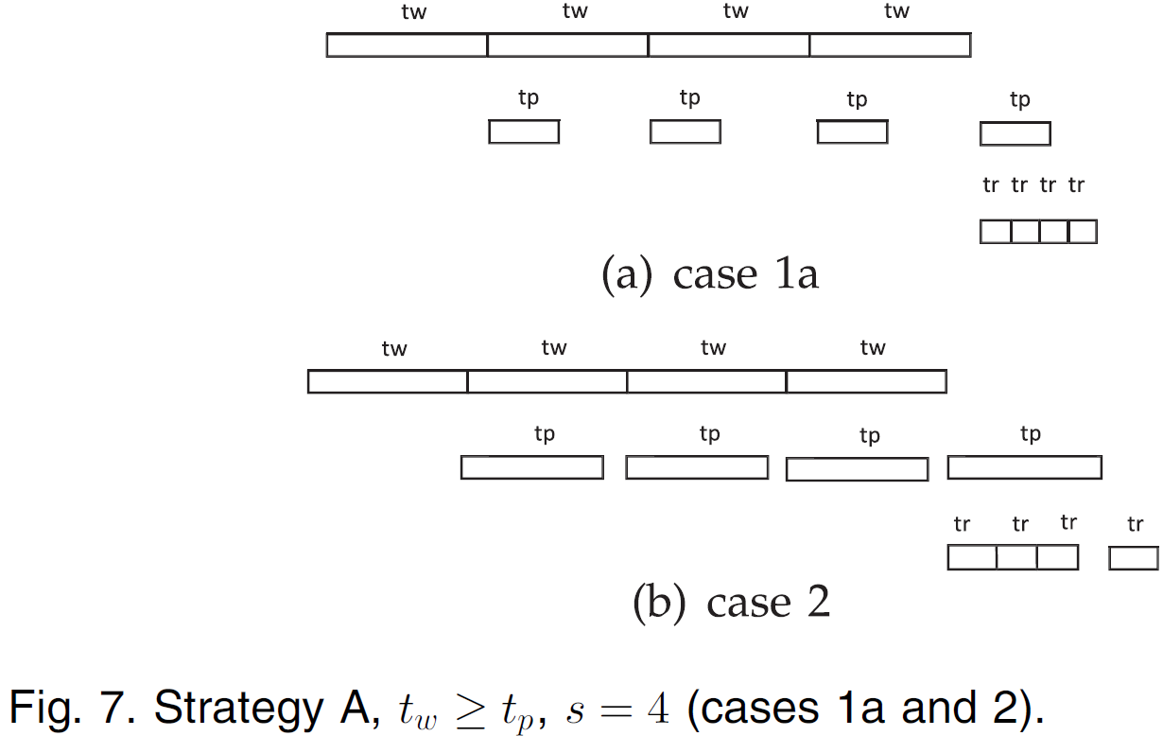


HOST-TO-HOST (Cont.)
Completion Time-One I/O Channel
Theorem 2
$$T_{w}+T_{r}$$
$$T_{w}+t_{p}+t_{r}$$

Slide 10
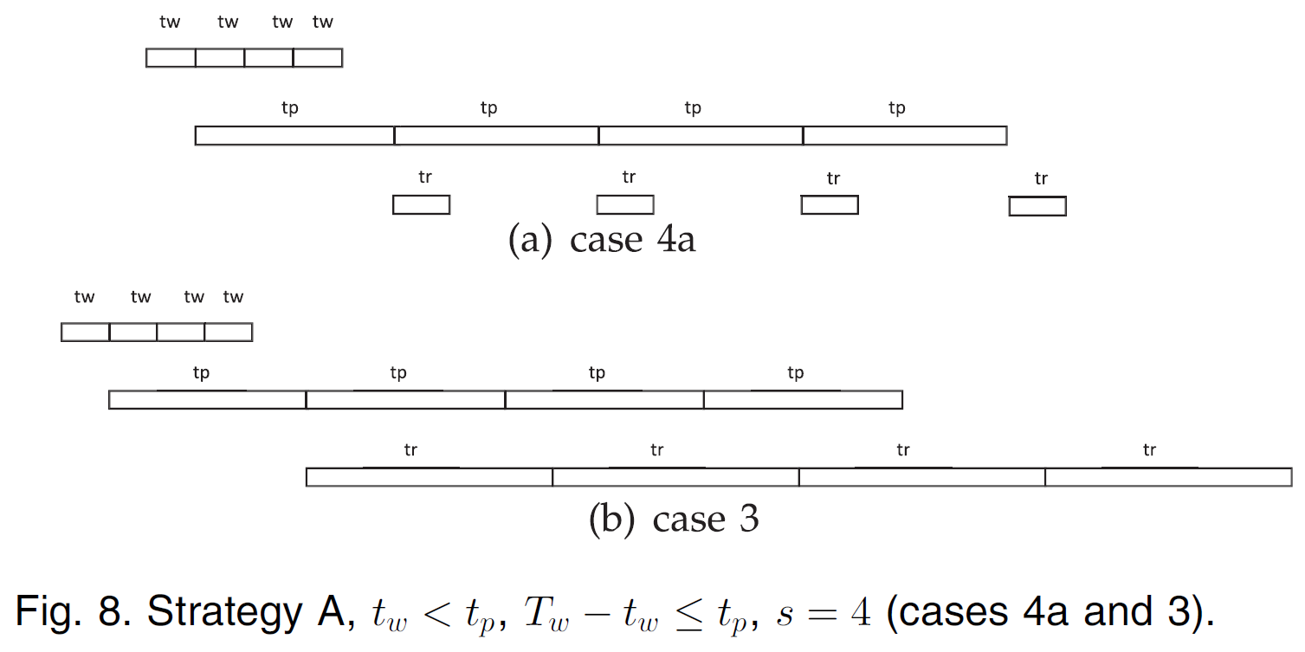


HOST-TO-HOST (Cont.)
Completion Time-One I/O Channel
Theorem 2
$$t_{w}+T_{p}+t_{r}$$
$$t_{w}+t_{p}+T_{r}$$

Slide 11
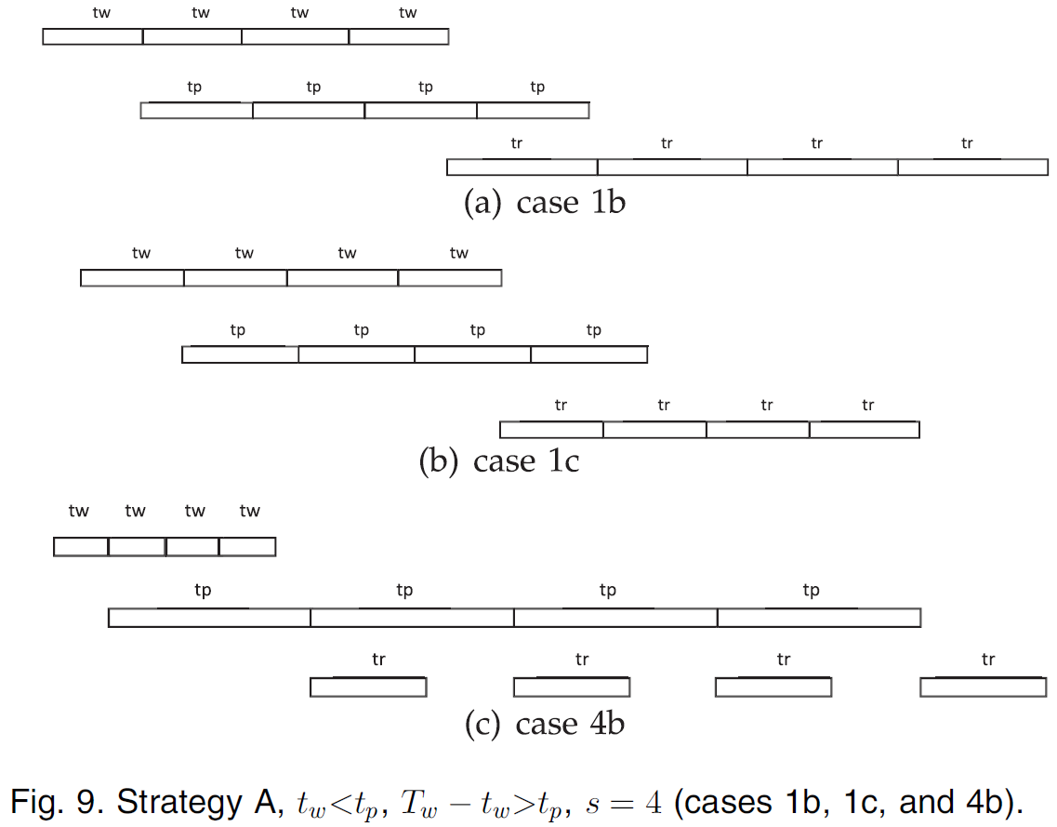



HOST-TO-HOST (Cont.)
Completion Time-One I/O Channel
Theorem 2
$$T_{w}+T_{r}$$
$$T_{w}+T_{r}$$
$$t_{w}+T_{p}+t_{r}$$

Slide 12

HOST-TO-HOST (Cont.)
Completion Time-One I/O Channel
Theorem 3.
  The completion time using strategy A is the minimum possible completion time for every combination of $t_{w}$, $t_{p}$, and $t_{r}$.
  $L=\{T_{w}+T_{r},T_{w}+t_{p}+t_{r},t_{w}+t_{p}+T_{r},t_{w}+T_{p}+t_{r}\}$

Slide 13

HOST-TO-HOST (Cont.)
Completion Time-One I/O Channel
Theorem 4.
  $T_{B}=t_{w}+\max\left\{t_{w},t_{p}\right\}+\left(s−2\right)\max\left\{t_{w}+t_{r},t_{p}\right\}$
  $$+\max\left\{t_{p},t_{r}\right\}+t_{r}$$
Write
process
read

Slide 14
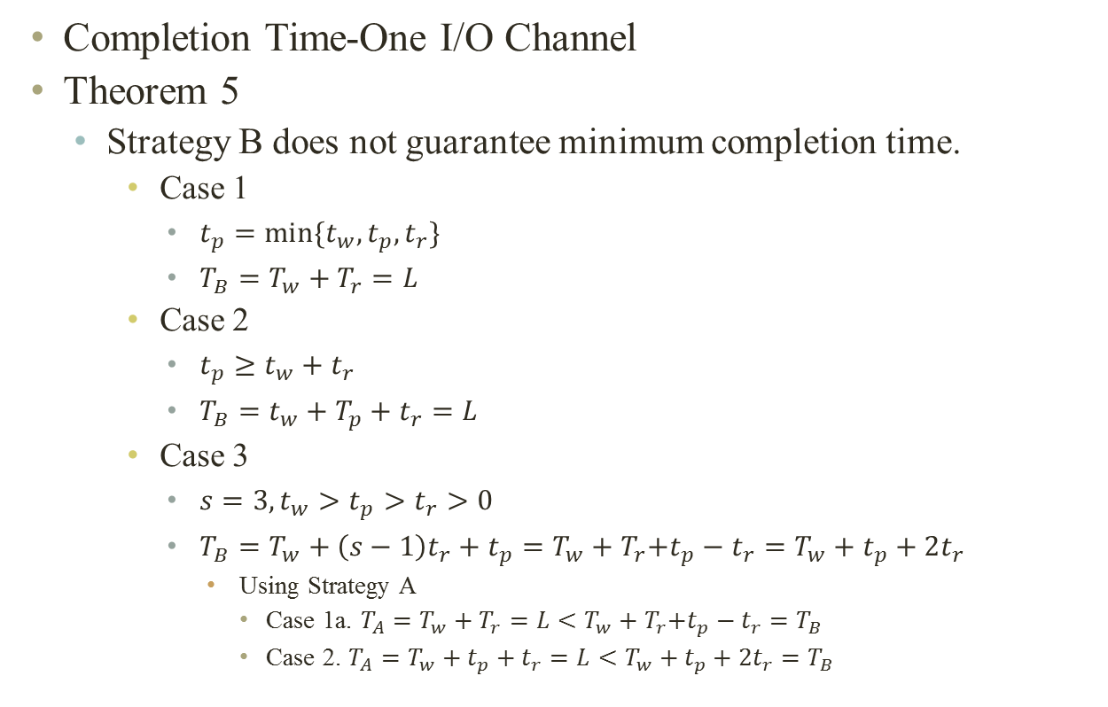
HOST-TO-HOST (Cont.)
Completion Time-One I/O Channel
Theorem 5
  Strategy B does not guarantee minimum completion time.
    Case 1
      $t_{p}=min⁡\{t_{w},t_{p},t_{r}\}$
      $T_{B}=T_{w}+T_{r}=L$
    Case 2
      $t_{p}≥t_{w}+t_{r}$
      $T_{B}=t_{w}+T_{p}+t_{r}=L$
    Case 3
      $s=3, t_{w}>t_{p}>t_{r}>0$
      $T_{B}=T_{w}+\left(s−1\right)t_{r}+t_{p}=T_{w}+T_{r}\text{+}t_{p}−t_{r}=T_{w}+t_{p}+2t_{r}$
        Using Strategy A
          Case 1a. $T_{A}=T_{w}+T_{r}=L<T_{w}+T_{r}\text{+}t_{p}−t_{r}=T_{B}$
          Case 2. $T_{A}=T_{w}+t_{p}+t_{r}=L<T_{w}+t_{p}+2t_{r}=T_{B}$

Slide 15

HOST-TO-HOST (Cont.)
Completion Time-One I/O Channel
Theorem 6.
  $\frac{T_{B}−T_{A}}{T_{A}}=0$ when $s≤2$ and $\frac{T_{B}−T_{A}}{T_{A}}<\frac{s−2}{s^{2}−1}≤\frac{2}{15}$ when $s>2$
  Strategy B becomes more competitive with strategy A as the number of segments s increases.

Slide 16
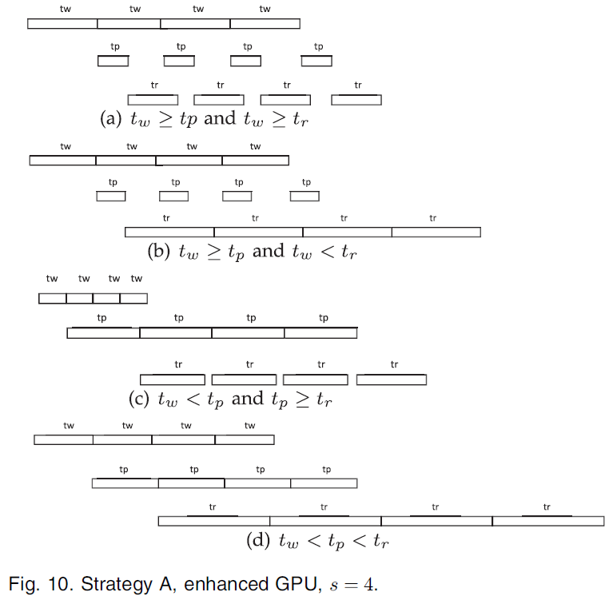




HOST-TO-HOST (Cont.)
Completion Time-Two I/O Channels
Theorem 7
$$T_{w}+t_{p}+t_{r}$$
$$t_{w}+t_{p}+T_{r}$$
$$t_{w}+T_{p}+t_{r}$$
$$t_{w}+t_{p}+T_{r}$$

Slide 17

HOST-TO-HOST (Cont.)
Completion Time-Two I/O Channels
Theorem 8
  For the enhanced GPU model, the completion time using strategy A is the minimum possible completion time for every combination of $t_{w}$, $t_{p}$, and $t_{r}$.
  $L=\{T_{w}+t_{p}+t_{r},t_{w}+T_{p}+t_{r},t_{w}+t_{p}+T_{r}\}$

Slide 18
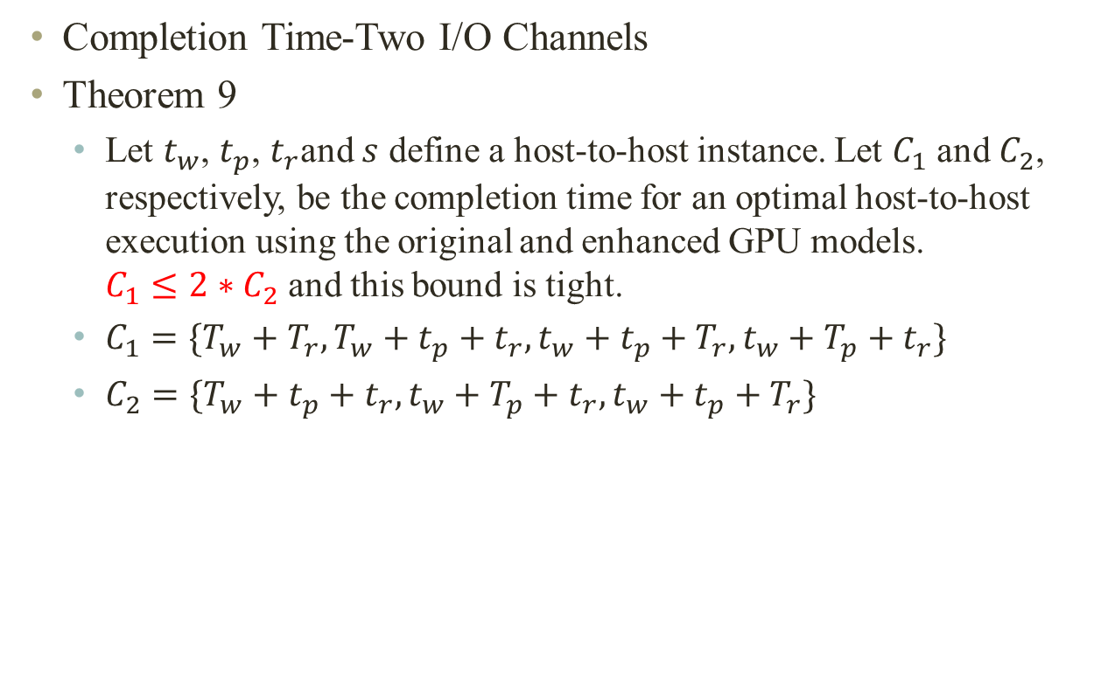
HOST-TO-HOST (Cont.)
Completion Time-Two I/O Channels
Theorem 9
  Let $t_{w}$, $t_{p}$, $t_{r}$and $s$ define a host-to-host instance. Let $C_{1}$ and $C_{2}$, respectively, be the completion time for an optimal host-to-host execution using the original and enhanced GPU models. $C_{1}≤2∗C_{2}$ and this bound is tight.
  $C_{1}=\{T_{w}+T_{r},T_{w}+t_{p}+t_{r},t_{w}+t_{p}+T_{r},t_{w}+T_{p}+t_{r}\}$
  $C_{2}=\{T_{w}+t_{p}+t_{r},t_{w}+T_{p}+t_{r},t_{w}+t_{p}+T_{r}\}$

Slide 19

HOST-TO-HOST (Cont.)
Completion Time-Two I/O Channels
Theorem 10
  $T_{B}=t_{w}+\max\left\{t_{w},t_{p}\right\}+\left(s−2\right)\max\left\{t_{w},t_{p},t_{r}\right\}$
  $$+\max\left\{t_{p},t_{r}\right\}+t_{r}$$
Write
process
read

Slide 20
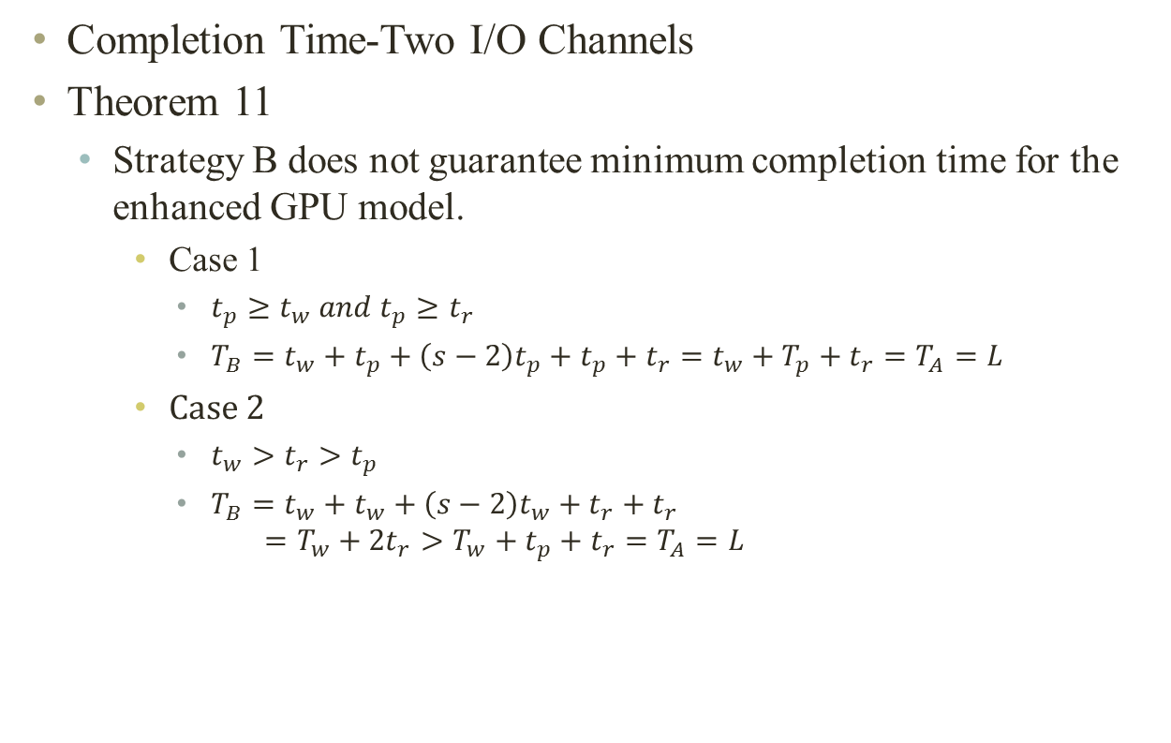
HOST-TO-HOST (Cont.)
Completion Time-Two I/O Channels
Theorem 11
  Strategy B does not guarantee minimum completion time for the enhanced GPU model.
    Case 1
      $t_{p}≥t_{w} and t_{p}≥t_{r}$
      $T_{B}=t_{w}+t_{p}+\left(s−2\right)t_{p}+t_{p}+t_{r}=t_{w}+T_{p}+t_{r}=T_{A}=L$
    Case 2
      $t_{w}>t_{r}>t_{p}$
      $T_{B}=t_{w}+t_{w}+\left(s−2\right)t_{w}+t_{r}+t_{r}$
      $$=T_{w}+{2t}_{r}>T_{w}+t_{p}+t_{r}=T_{A}=L$$

Slide 21

HOST-TO-HOST (Cont.)
Completion Time-Two I/O Channels
Theorem 12
  $\frac{T_{B}−T_{A}}{T_{A}}=0$ when $s=1$ and $\frac{T_{B}−T_{A}}{T_{A}}<\frac{1}{s+1}≤\frac{1}{3}$ when $s>1$

Slide 22
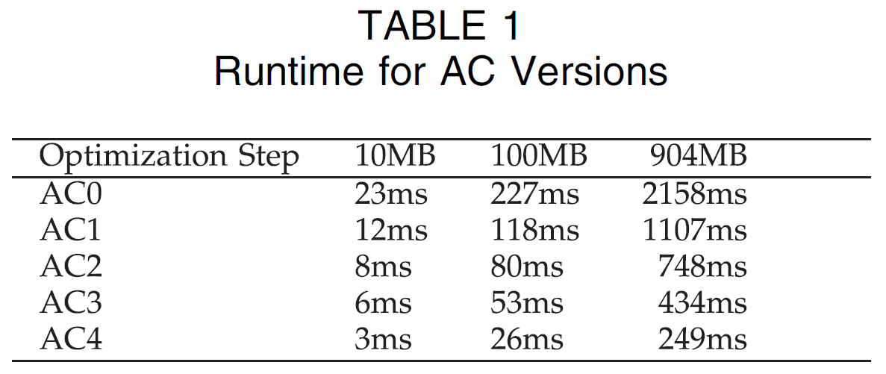

Experimental Results
$maxL=17$, $T=64$, $S_{block}=14,592$, $S_{thread}=S_{block}/T=228$ and $tWord=S_{thread}/4=57$
33 patterns, $n=10, 100, and 904MB$

Slide 23
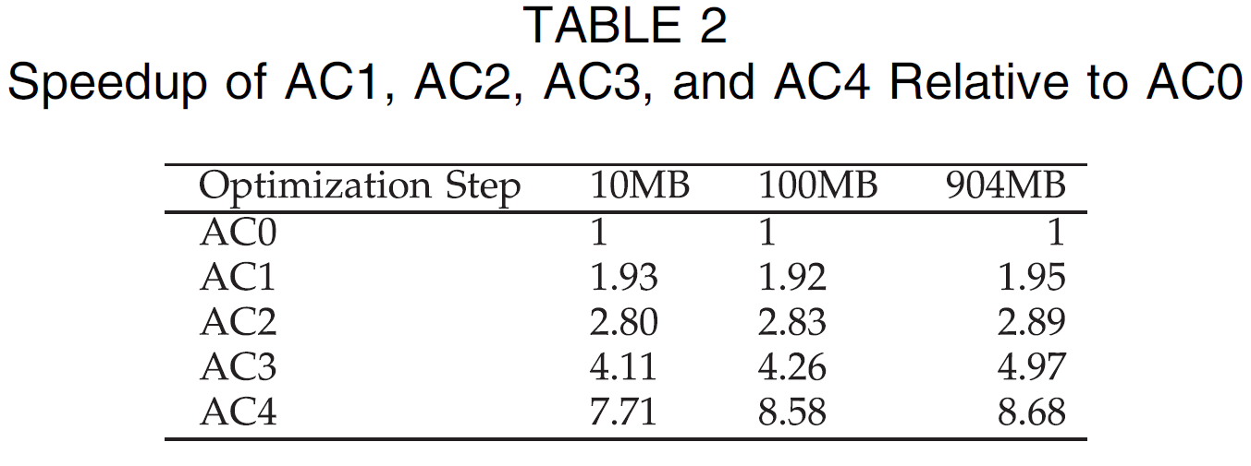
Experimental Results (Cont.)
$maxL=17$, $T=64$, $S_{block}=14,592$, $S_{thread}=S_{block}/T=228$ and $tWord=S_{thread}/4=57$
33 patterns, $n=10, 100, and 904MB$

Slide 24
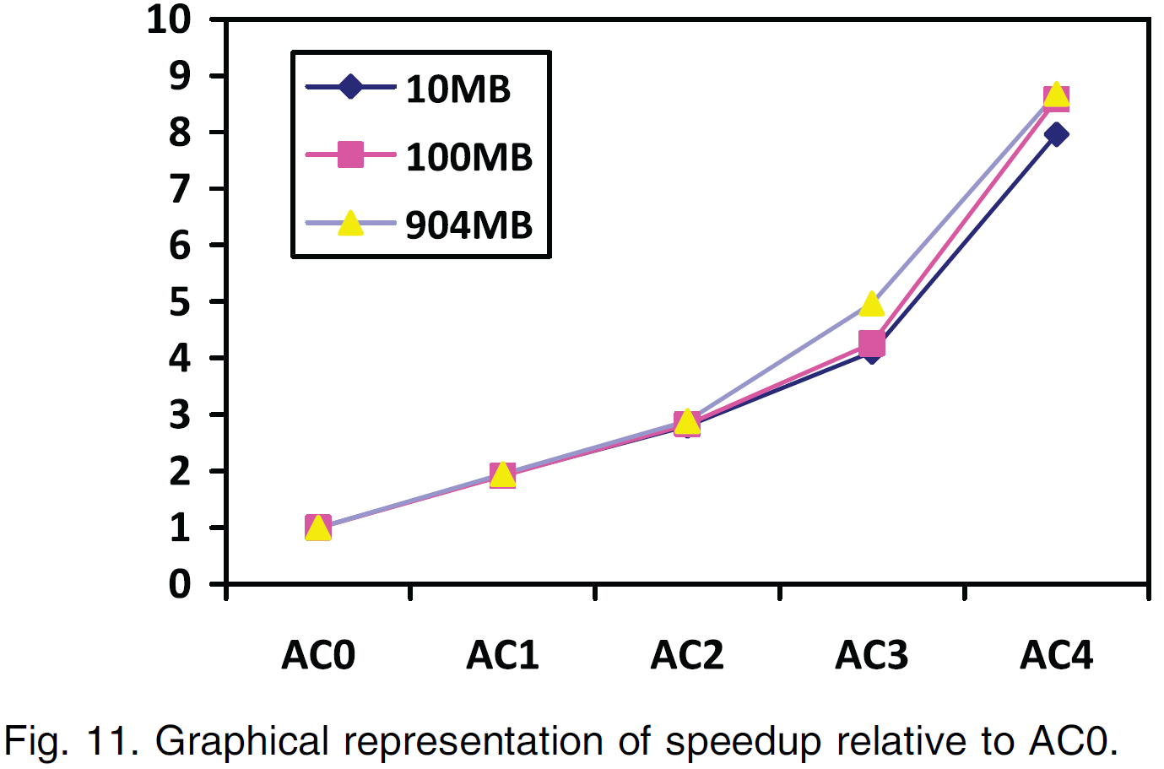
Experimental Results (Cont.)
$maxL=17$, $T=64$, $S_{block}=14,592$, $S_{thread}=S_{block}/T=228$ and $tWord=S_{thread}/4=57$
33 patterns, $n=10, 100, and 904MB$

Slide 25
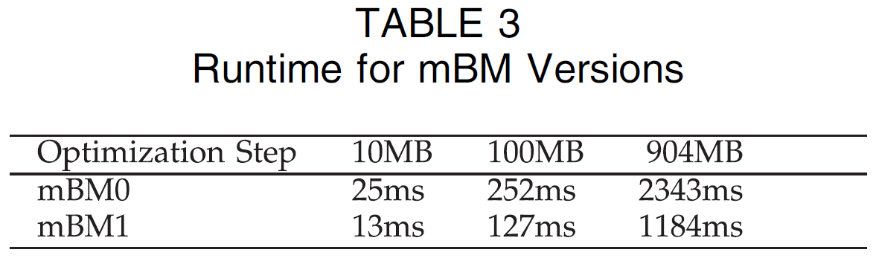
Experimental Results (Cont.)
$maxL=17$, $T=64$, $S_{block}=14,592$, $S_{thread}=S_{block}/T=228$ and $tWord=S_{thread}/4=57$
33 patterns, $n=10, 100, and 904MB$

Slide 26
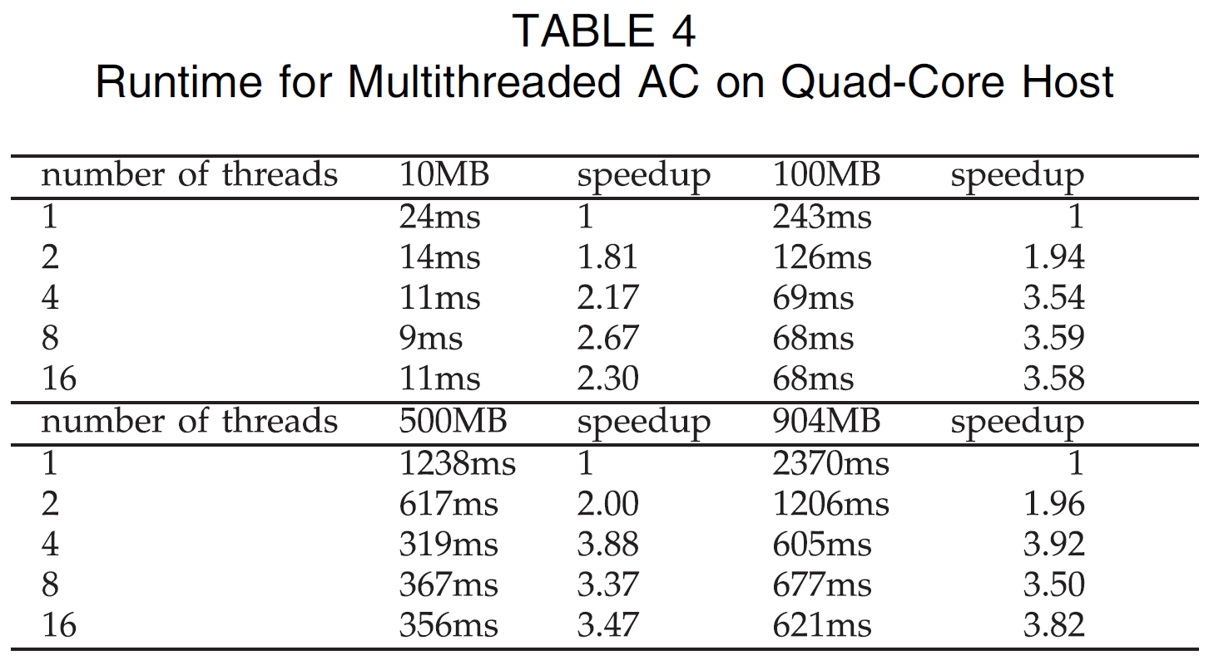
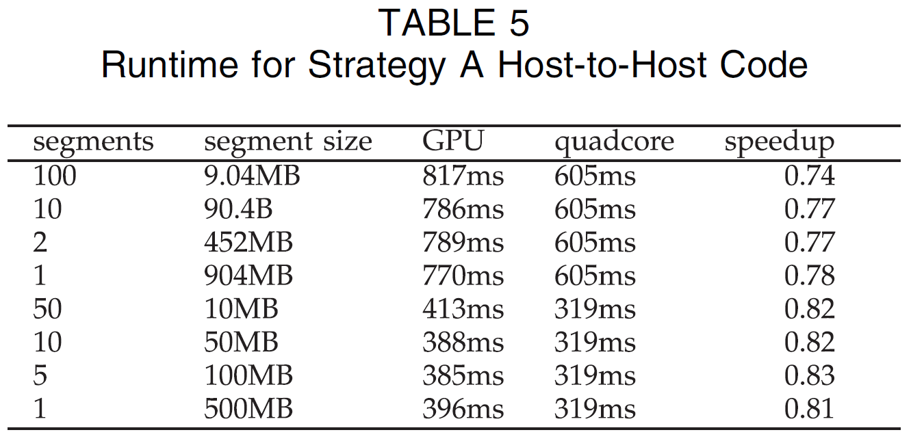
Experimental Results (Cont.)

